Slide 1
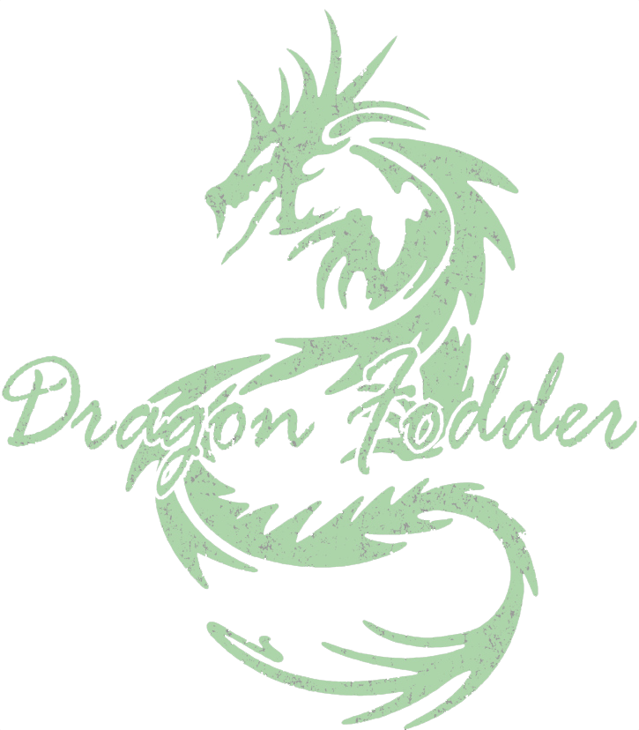

Dragon Fodder @ Reno Pop Culture Con
Session 1: Session Zero & Character Creation
Session 2: Player 101
Session 3: DM 101
Session 4: Adventure Creation / Worldbuilding
Session 5: Live Play Pt 1
Session 6: Live Play Pt 2
https://github.com/majornerd/dragonfodder

Slide 2
Dragon Fodder @ Reno Pop Culture Con
Session 1: Session Zero & Character Creation
Session 2: Player 101
Session 3: DM 101
Session 4: Adventure Creation / Worldbuilding
Session 5: Live Play Pt 1
Session 6: Live Play Pt 2

Slide 3

Goals: Start from Zero
We will start from zero and end the weekend with live play
Participation will be rewarded
We have gifts
The sessions will be a mix of “How to get started” and “Lifehacks”

Slide 4
Session Zero
Session Zero is a critical “Pre-game” session
Goals of Session Zero:
Character Creation
Align player goals
Provide background on the game world

Slide 5
What Makes D&D (TTRPG) Unique
Party Play – more than any other game, party play is a key component of D&D. The entire party must be represented for the game to be a success
Strategy – D&D is a strategic game. How you approach each part of the game is a strategy and one as open as possible in a gaming setting
Non-combat Play – the Non-Combat portion of the game is as important, maybe more, than the combat portion. Great accomplishments in the fantasy world can come from Non-Combat play
Communal – A party is a group of people, the communal aspect is important and valuable

Slide 6
It’s PARTY play, not "person" play

Slide 7
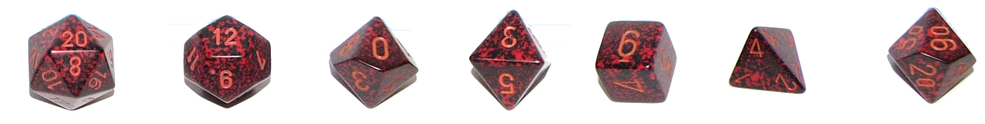
Tools We Use (Must Have)
Dice (D20, D12, D10, D8, D6, D4)
a set includes 7 die (one is a D10 marked 10-00 for rolling D100 with the other D10)
D&D 5e – Basic Rules to Play
https://media.wizards.com/2018/dnd/downloads/DnD_BasicRules_2018.pdf
D&D Beyond:
https://www.dndbeyond.com/
Free Character sheet with integrated SRD!
Post-It’s and Pens
Just really useful for notes

Slide 8
Tools We Use (Recommended)
Play Mat and Wet Erase Markers
Mat ($27.99) https://www.amazon.com/Battle-Grid-Game-Mat-36/dp/B01MQHECUR/
Markers ($12.99) https://www.amazon.com/16678B-Wet-Erase-Overhead-Transparency-Assorted/dp/B002R5AEC0
Dice Tray
Single ($8.99) https://www.amazon.com/Leather-Folding-Hexagon-Purple-Storage/dp/B07DZJJ7CS
Set of 4 ($16.99) https://www.amazon.com/K-T-Fancy-Folding-Storage-Rolling/dp/B07Y35799H
Mini’s
~$5.99 for two – I recommend your Local Gaming Store (LGS) for these
Soda Rings
(Free*) these are the plastic rings on a soda (and other) bottle.
Counters
Each D&D Mini package contains 2, but you can use coins, tokens, poker chips…..
DM Screen
Allows you to have notes and info, as well as make rolls without revealing the result *Optional

Slide 9
Tools We Use (Online Tools)
Reddit - At least 10 subreddits for D&D https://old.reddit.com
Getting Started: Player - https://www.reddit.com/r/DnD/wiki/getting_started
Getting Started: DM - https://www.reddit.com/r/DnD/wiki/new_dm_guide
DMs Guild
Tons of free content, including adventures: https://www.dmsguild.com/
DonJon – The best tools here are: Random Dungeon Generator, Encounter Size Calc, Random Generator: https://donjon.bin.sh/5e/
One Page Dungeon – Every refresh is a new dungeon (Hint: Print to PDF) https://watabou.itch.io/one-page-dungeon
Kobold Fight Club – Really good encounter builder https://kobold.club/fight/#/encounter-builder
YouTube
Matt Coleville (The best resource for a DM) - https://www.youtube.com/channel/UCkVdb9Yr8fc05_VbAVfskCA
Matt Mercer (of Critical Role fame) - https://www.youtube.com/user/geekandsundry
Podcasts
YMIAT – You Met in a Tavern - https://youmeetinatavern.podbean.com/
Critical Role - https://www.youtube.com/user/geekandsundry
The Hombrewery
Make your Homebrew look official: https://homebrewery.naturalcrit.com/
D&D 5e SRD (System Resource Document) – Homebrew: https://media.wizards.com/2016/downloads/DND/SRD-OGL_V5.1.pdf

Slide 10
Tools We Use (Online Tools)
Reddit - At least 10 subreddits for D&D https://old.reddit.com
Getting Started: Player - https://www.reddit.com/r/DnD/wiki/getting_started
Getting Started: DM - https://www.reddit.com/r/DnD/wiki/new_dm_guide
https://old.reddit.com/r/DMToolkit/
https://old.reddit.com/r/DnD/
https://old.reddit.com/r/DnDBehindTheScreen/
https://old.reddit.com/r/DnDHomebrew/
https://old.reddit.com/r/DMAcademy/
https://old.reddit.com/r/dndmonsters/
https://old.reddit.com/r/DungeonsAndDragons/
https://old.reddit.com/r/DMporn/
https://www.reddit.com/r/DnDBehindTheScreen/
https://www.reddit.com/r/onePageDungeon/
https://dmdavid.com/tag/7-dungeons-dragons-character-builds-absurdly-good-at-one-thing/
http://gdnd.wikidot.com/character-creation

Slide 11
Let’s Build a Character
(Feel free to follow along on your device)
How to handle rolls?!?
Roll 4x D6, re-roll any 1’s, discard the lowest
7 rolls, discard the lowest
Heroes not Zeroes

Slide 12
How to Play!!
When in doubt, try
Everyone’s game is different
Don’t worry about role playing

Slide 13
Phases of Play
Movement, Action, Bonus Action
Movement is limited by your total movement and modifiers
Modifiers may be terrain, character effects (Grapple, Prone, etc)
Be aware of Engagement and Opportunity Attacks
Actions are things you do:
Attack, Cast a Spell, Dash, Disengage, Dodge, Help, Hide, Ready, Search, Use an Object
Know your character sheet – D&D Beyond will automatically update your sheet with options – including multiple attacks, if possible
Bonus Action
Also things you can do, but may be dependent on something as your action
Two Weapon Fighting is a good example, requires an attack action with a simple, melee weapon; may be a spell, “bardic inspiration”
Reactions are NOT part of your turn, but an action you take based on something another player, NPC, enemy, etc., does – NOT something YOU do.

Slide 14
Pace of Play – a round is 6 seconds - total
It’s like Golf, make sure you are ready and not slowing the game down
How:
Figure out your “action” before it is your turn, so you are ready to go
Have a “Default Action” that is your go-to if you are unsure what else to do
Roll “To Hit” and “Damage” dice at the same time. If you hit, you already know your damage
Cheat sheets
Have an index card that has your commonly used attacks on it & “to hit” & Damage
Also: AC (armor class), Init (initiative)

Slide 15
Avoid::::::::
Slowing the game the same way each time
Metagaming (using information in the game that your player cannot or does not know), such as:
the stats of a monster you have never fought
information given to an individual player
information available to those in a room you are not in

Slide 16
Character Creation
How to roll
What is important
Have fun
TALK TO THE OTHER PLAYERS!
20 questions
What do you look like
How do strangers see you
What was your upbringing
Are you still in contact with people from your childhood
Why did you become an adventurer
Where have you been already
Do you believe in the Gods? Do you follow one?
How do you feel about Magic?
What is worth dying for?
What is your dream?
What is your stance on morals or the law
How do you deal with strangers?
How do you place a value on a persons life? Animals?
Do you see all races as the same?
Does your hero like arts?
What’s your favorite meal?
What about love?
Do you have a dark secret?

Slide 17
Goal: To have stories to tell about the last session.
If three sessions pass without a story, revisit your DM strategy and see how you can enable the creation of one.

Slide 18
Role of the DM
The Narrator
The Referee

Slide 19
Not you vs. the Players
The DM is the narrator to the story, not the storyteller
The players are a part of the storytelling
They represent the 3rd-person characters in the book
The DM is the referee, not against the players

Slide 20
Rule of Cool Yes and; No but

Slide 21
DM'ing
Play the NPC / Enemy – they are motivated like the player – they may not want to die

Slide 22
Be Consistent
(Even when Inconsistent)

Slide 23
Ruling – the DM is always right
When making a decision and you are unsure how it should go, lean towards the decision that benefits the player
Use the start of the next session to revisit corrections to last week's play
** Take 30 Minutes at the start of each session to recap the last session**

Slide 24
Character Hoarding
Characters tend to hoard. Use pacing to force them to spend.
Spending limited resources adds tension and excitement.
If your characters are completing milestones with unused spell slots, your pacing is off.

Slide 25
Leveling
Think about the milestone mechanic, instead of using XP
This allows you to better control how/when leveling occurs
Regardless, think about how you will level the characters and where/when that will occur

Slide 26
Handouts
Players love handouts
Don’t make it complicated
A map is great: background on the location, or a history of the world or region

Slide 27
Magic Items for Players
When you think about magic items for the players consider a couple early on in the game:
Handy Haversack
Magic Armor
These Items are extremely useful to the players and a simple +1 to AC has the ability to drastically increase the survivability of low level characters

Slide 28
Consider grace periods
Players should be encouraged to experiment. In that vein, consider letting your players experiment with choices and give them a one-session grace period to correct them
Focus on PARTY balance, not one player, but the party should be balanced

Slide 29
Party Size
There is an “ideal” party size
Needs to be large enough to be well rounded and competitive
Not so large chaos rules or players get bored waiting for something to do
Aim for a minimum of 4 players
Maximum of 6 Players
Consider “quorum play” when scheduling. 1 player cannot make it? No problem, someone else can drag them for a session

Slide 30
D&D Beyond is your best friend
D&D Beyond
Start a campaign
Invite characters
Open a tab for each character

Slide 31
Encounter Management
Encounter Calculator, Encounter Calculator, EC
Balance…. Characters should be paced in encounters. Sometimes you want them to be winded
Figure 30 minutes per encounter
Tons of online tools:
D&D Beyond
Kobold Fight Club – Really good encounter builder https://kobold.club/fight/#/encounter-builder

Slide 32
Metagaming
Metagaming (using information in the game that your player cannot or does not know), such as:
the stats of a monster you have never fought
information given to an individual player
information available to those in a room you are not in

Slide 33
How to DM
KISS – It does not need to be larger-than-life or complex
Start with “You meet in a tavern”
Add Complexity over time
Alignment Matters – LG will have conflict with CE
Lawful / Chaotic – Rules matter, or do not
Good / Evil – Benefit others or myself
When in Doubt – Roll the Bones
Pace of Play
Rest – value and challenge (feel free to roll…..)

Slide 34
Dragon Fodder @ Reno Pop Culture Con
Session 1: Session Zero & Character Creation
Session 2: Player 101
Session 3: DM 101
Session 4: Adventure Creation / Worldbuilding
Session 5: Live Play Pt 1
Session 6: Live Play Pt 2

Slide 35
Start Small
Start with why, why is interesting
Why are adventurers needed?
Who runs things
What happened 200 years ago
Is this a successful empire, or is there a lost king/kingdom

Slide 36
Start Small
Start with a place, simple place,
Town, Camp Trail, Dungeon – what do the players see, hear, smell right now
Expand as they move

Slide 37
Start Small
Build over time, but see where the players are going first
Change your world to suit the narrative
If the players go west, move some of the things you have planned for the east to the west
Or, if they go west they find the cliffs of despair and nowhere to go….

Slide 38
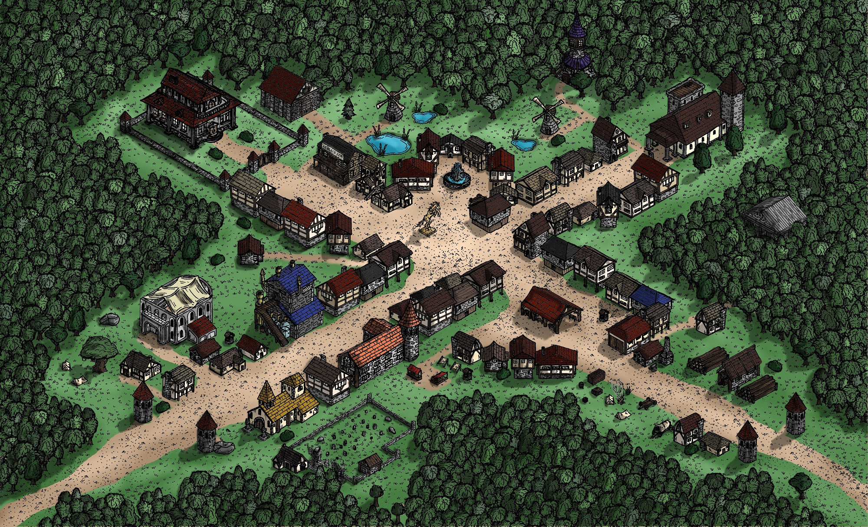
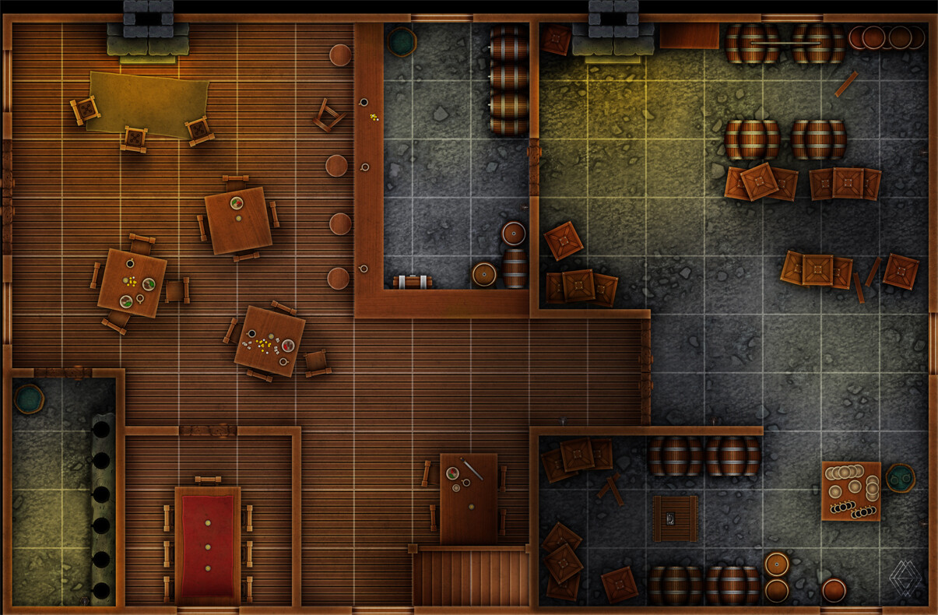
Start Small
Use Google Images
Town –>
Tavern --------------------->

Slide 39
You Meet in a Tavern
KISS – It does not need to be larger-than-life or complex
Start with “You meet in a tavern”

Slide 40
Tip - Alignment
Alignment Matters – LG will have conflict with CE
Lawful / Chaotic – Rules matter, or do not
Good / Evil – Benefit others or myself

Slide 41
How to DM
Party Size
Minimum 3 players, Maximum 6
Encounter Calculator, Encounter Calculator, EC
Balance…. Characters should be paced in encounters. Sometimes you want them to be winded

Slide 42
Consider a Minion House Rule
Minions are simplified enemies that have unified stat blocks (the same for all the minions) and 1 HP
They are designed to allow for rapid play
One hit and they go down, simplifies the DM’s effort

Slide 43
Tools We Use (Online Tools)
DMs Guild – free content (change it to make it yours)
Tons of free content, including adventures: https://www.dmsguild.com/
DonJon – The best tools here are: Random Dungeon Generator, Encounter Size Calc, Random Generator: https://donjon.bin.sh/5e/
One Page Dungeon – Every refresh is a new dungeon (Hint: Print to PDF) https://watabou.itch.io/one-page-dungeon
Kobold Fight Club – Really good encounter builder https://kobold.club/fight/#/encounter-builder
The Hombrewery
Make your Homebrew look official: https://homebrewery.naturalcrit.com/
Fantasy Map Generator:
https://azgaar.github.io/Fantasy-Map-Generator/

Slide 44
Tools We Use (Online Tools)
Reddit - At least 10 subreddits for D&D https://old.reddit.com
https://old.reddit.com/r/DMToolkit/
https://old.reddit.com/r/DnD/
https://old.reddit.com/r/DnDBehindTheScreen/
https://old.reddit.com/r/DnDHomebrew/
https://old.reddit.com/r/DMAcademy/
https://old.reddit.com/r/dndmonsters/
https://old.reddit.com/r/DungeonsAndDragons/
https://old.reddit.com/r/DMporn/
https://www.reddit.com/r/DnDBehindTheScreen/
https://www.reddit.com/r/onePageDungeon/
https://dmdavid.com/tag/7-dungeons-dragons-character-builds-absurdly-good-at-one-thing/
http://gdnd.wikidot.com/character-creation

Slide 45
Dragon Fodder @ Reno Pop Culture Con
Session 1: Session Zero & Character Creation
Session 2: Player 101
Session 3: DM 101
Session 4: Adventure Creation / Worldbuilding
Session 5: Live Play Pt 1
Session 6: Live Play Pt 2

